Slide 1
Digital Champion training for young people
Why and how to help someone else use digital technology

Slide 2
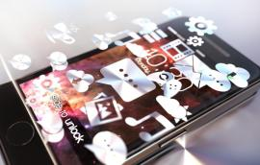
Overview This is a 2.5/ 3 hour training session which includes some short tasks for you to complete on your own or in small groups
At the end of the session you should have developed an understanding of: The benefits and barriers to getting online How to go about assisting beginners and intermediate digital learners Some practical skills that will help you start to plan a lesson The important people skills needed to inspire and help people get online The ways in which you may be able to volunteer your time to help others The safety issues relating to volunteering and teaching others to use the internet.

Slide 3
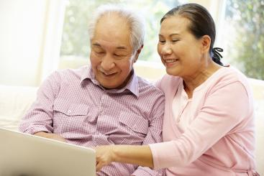
Not everyone is online, or can use a computer
4.3 million adults (8% of the population) have no experience of using a computer (2018)
People with a registered disability are four times as likely to be offline
28% of people over 60 are not online

Slide 4
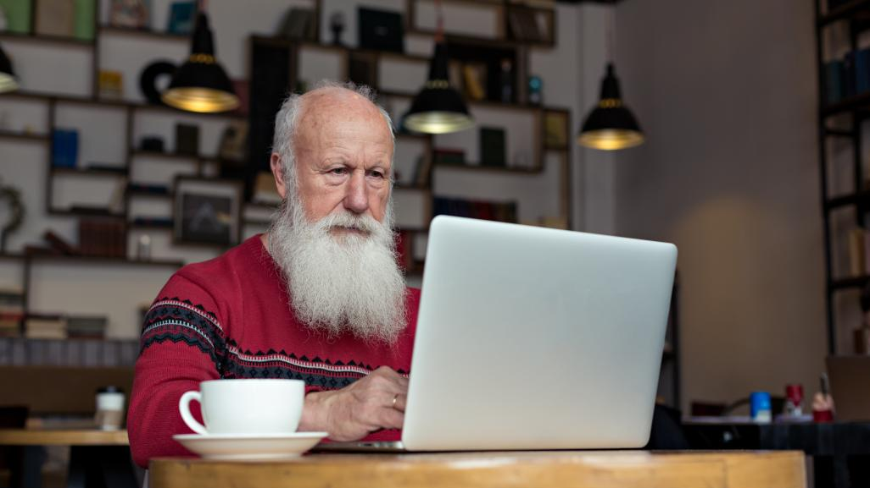
Task A: Discussion What benefits would learning to use a computer, or the internet bring to an elderly person who has never used the internet before?

Slide 5
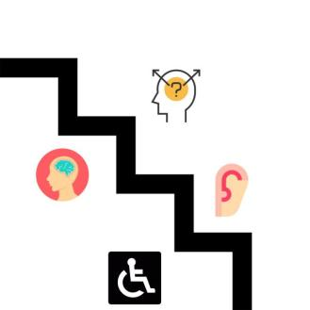
Task B: Discussion What factors may stop someone from using a computer or getting online?

Slide 6
Task D: Discuss in groups What would you do to help a learner new to computers to ensure their learning was fun and useful?

Slide 7
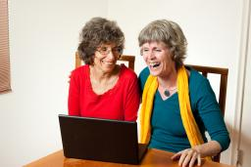
Some ideas of things to include in sessions
Be prepared to explain keyboard shortcuts
If the learner struggles with a mouse get them to try the tab or cursor keys
Finding something the learner is interested in is a good start
Use comparisons with things that the learner might be familiar with (e.g. a filing cabinet)
Keep it simple, avoid jargon
Go slowly

Slide 8
Task G: Discuss in your groups: * How did it feel to be a Champion? * How did it feel to be a learner? * What teaching techniques seemed effective? Feedback to the whole group

Slide 9
Task H: Discussion
What might people at beginner level want to learn?

Slide 10
Some ideas of what a beginner might want to learn
Skill | Reason
Using a mouse | To be able to use the internet effectively
Using a keyboard | To be able to use a computer effectively
Email | To keep in touch with family and friends, email about housing, etc.
Skype | To keep in touch with family and friends, see grandchildren and great grandchildren growing up.
eBay | To buy different things online for home delivery
Grocery shopping online | To get the weekly grocery shop delivered
Creating documents | To make cards or notices
Internet safety | To keep personal details, secure online
Internet safety | To keep visiting children safe when using the internet

Slide 11
Task K
What one fact did you find interesting from today’s session?
What has been the most useful thing you have learnt?
Write on a stick notes

Slide 12
Staying safe when volunteering
Always make sure someone else knows where you are going
Always carry a mobile phone
Be selective with regard to how much personal information you give out
Don’t ‘friend’ your learners on social media
Plan your journey there
Trust your instincts
www.suzylamplugh.org

Slide 13
Evaluation
Further resources and guides
www.digitalunite.com

